Slide 1
Automatic Slide Generation
Athar Sefid¹, Jian Wu (speaker)², Presenjit Mitra¹, Clyde Lee Giles¹
¹Pennsylvania State University
²Old Dominion University
Jian Wu’s email: jwu@cs.odu.edu

Slide 2
Importance of Presentation Slides
In General
Summarized format of work
Covers the main issues
Convinces the audience of its importance
A picture is worth a thousand words

Slide 3
Scientific Papers
Scientific papers are presented at conferences, interviews, classes, etc.
Scientific papers usually have significant amount of text
Summarizing the main concepts of scientific papers helps the audiences understand the paper
Automatic slide generation
Provides a good initial description of the work
Saves the presenter time
Saves readers’ time

Slide 4


Data Collection
Web
Crawl web to collect paper-slide pairs
Extract header and body of paper (by GROBID)
Slide
Generator Module
1,200 paper-slides
crawler
Pre-process
Convert to PDF (by Libre office)
Extract text (by pdf to text)
Notes:
The data set contains a set of 1200 pairs of scientific papers and their corresponding power points made by their authors.
The header and body of the pdf files are extracted by Grobid
All of the ppt or pptx files are converted to pdf using libreoffice commands
Text is extracted from the pdf format of the power point file using pdftotext command

Slide 5
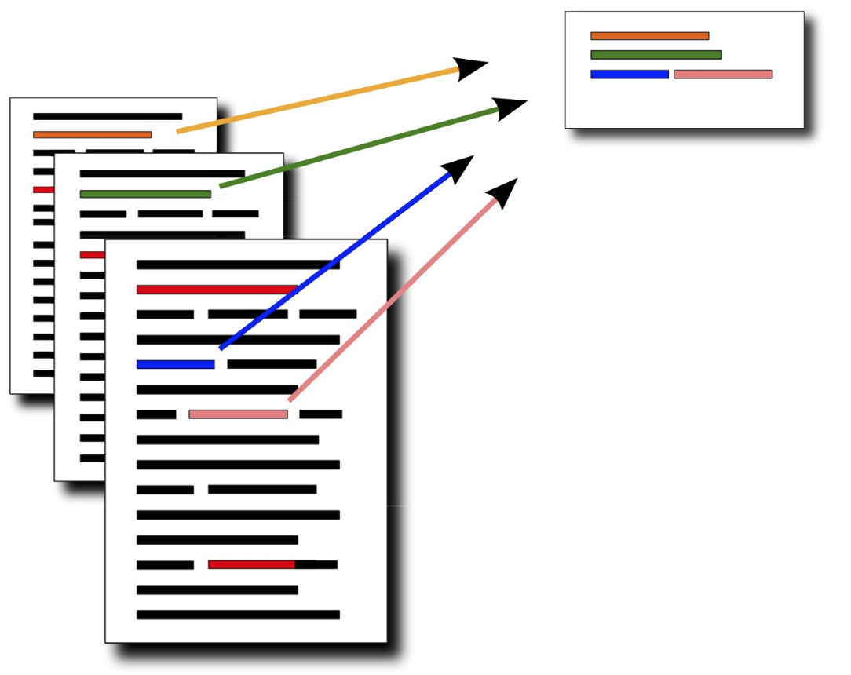
Paper Summarization
Summarization methods
Extractive
Selects sentences that have correct grammatical structure
Are scientifically/technically consistent with the original article
Abstractive
Works well for small summarization tasks such as news headlines
Summary contains new words, phrases and sentences outside of the vocabulary of the source document

Slide 6
Sentence Scoring
Processing flowchart of our approach
syntax
context
semantic
Extract Text
GROBID
Sentence Selection
ILP
Greedy
Phrase extraction
As bullet points
Slide generation
Title setting
Parse Text
StanfordCoreNLP
Sentence Labeling

Slide 7
Sentence Scoring
Processing flowchart of our approach
syntax
context
semantic
Extract Text
GROBID
Sentence Selection
ILP
Greedy
Phrase extraction
As bullet points
Slide generation
Title setting
Parse Text
StanfordCoreNLP
Sentence Labeling

Slide 8
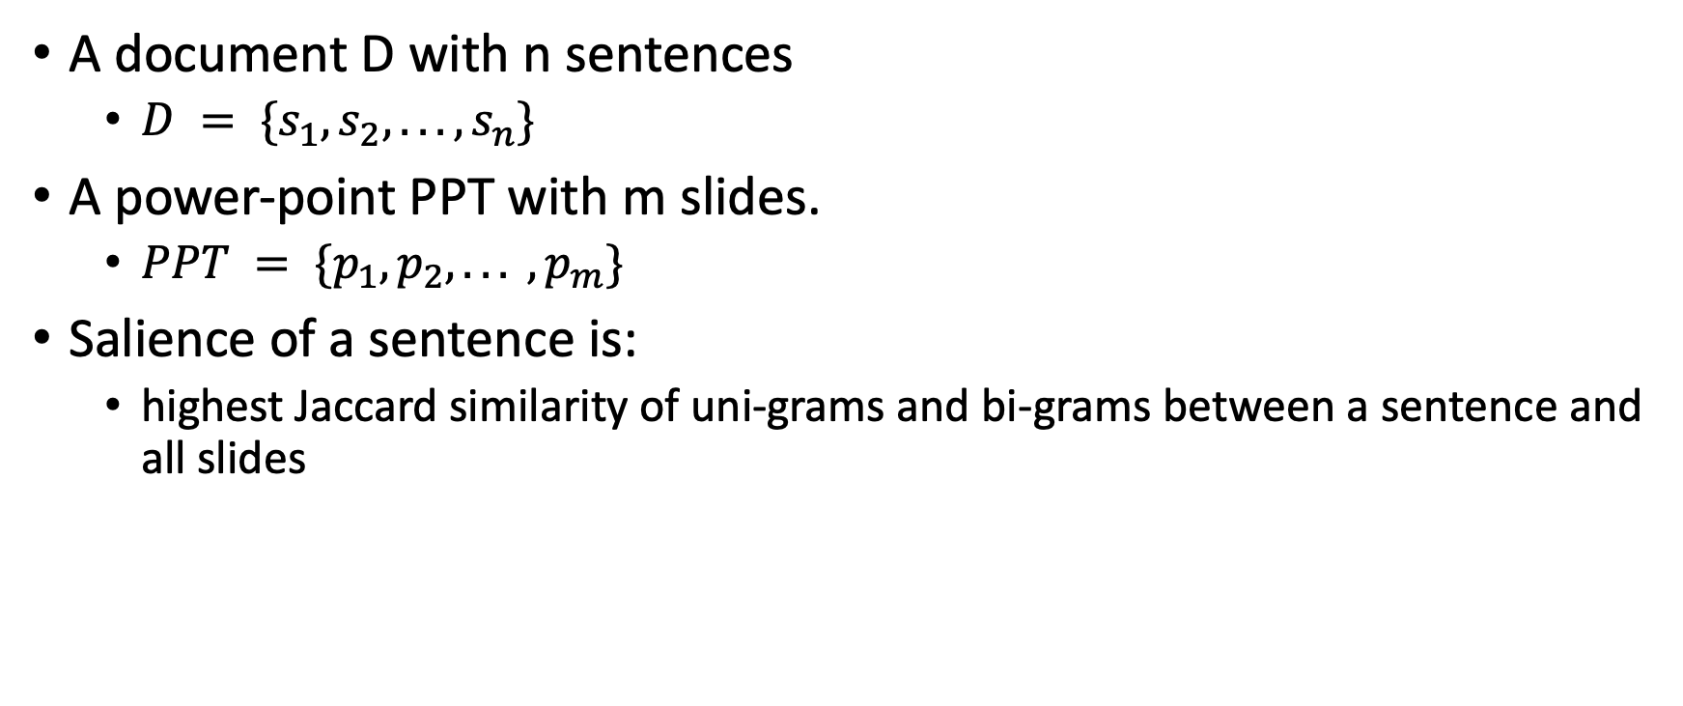
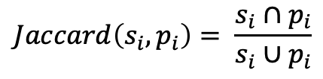
Sentence labeling
A document D with n sentences
$D = \{s_{1}, s_{2}, . . . , s_{n}\}$
A power-point PPT with m slides.
$PPT = \{p_{1}, p_{2}, . . . , p_{m}\}$
Salience of a sentence is:
highest Jaccard similarity of uni-grams and bi-grams between a sentence and all slides
$$∀s_{i}, Score_{s_{i}}=MAX_{p_{i}∈PPt} Jaccard \left(s_{i},P_{i}\right)$$
$$Jaccard\left(s_{i}, p_{i}\right)= \frac{s_{i}∩p_{i}}{s_{i}{∪p}_{i}}$$
Notes:
Modified jaccard:
Interesection(s, p) / mod(s)

Slide 9
Sentence Scoring
Processing flowchart of our approach
semantic
syntax
context
Extract Text
GROBID
Sentence Selection
ILP
Greedy
Phrase extraction
As bullet points
Slide generation
Title setting
Parse Text
StanfordCoreNLP
Sentence Labeling

Slide 10
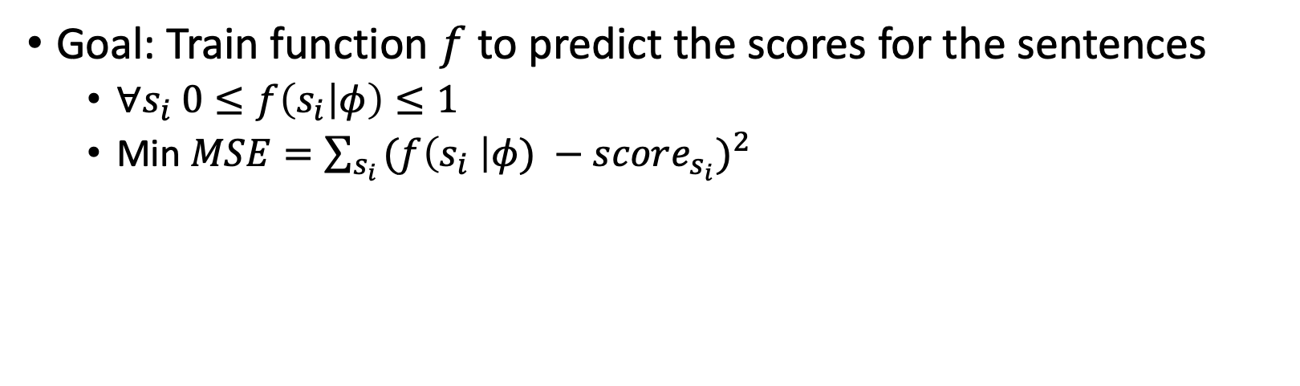
Sentence scoring
Goal: Train function $f$to predict the scores for the sentences
$∀s_{i} 0≤f\left(s_{i} | φ\right)≤1$
Min $MSE=\sum_{s_{i }}{{(f\left(s_{i} \right|φ) −score_{s_{i}})}^{2}}$

Slide 11
Sentence Scoring
Processing flowchart of our approach
semantic
syntax
context
Extract Text
GROBID
Sentence Selection
ILP
Greedy
Phrase extraction
As bullet points
Slide generation
Title setting
Parse Text
StanfordCoreNLP
Sentence Labeling

Slide 12
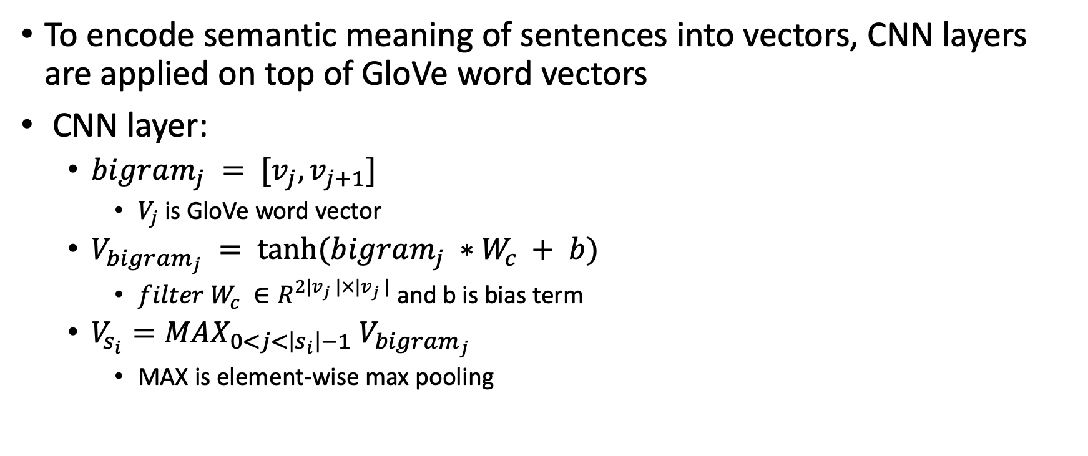
Semantic embedding (CNN)
To encode semantic meaning of sentences into vectors, CNN layers are applied on top of GloVe word vectors
CNN layer:
$bigram_{j} = [v_{j},v_{j+1}]$
$V_{j}$ is GloVe word vector
$V_{bigr{am}_{j}} = tanh⁡(bigram_{j} ∗W_{c} + b)$
$filter W_{c} ∈R^{2|v_{j} |×|v_{j} | }$and b is bias term
$V_{s_{i}}=MAX_{0<j<\left|s_{i}\right|−1} V_{bigram_{j}}$
MAX is element-wise max pooling

Slide 13
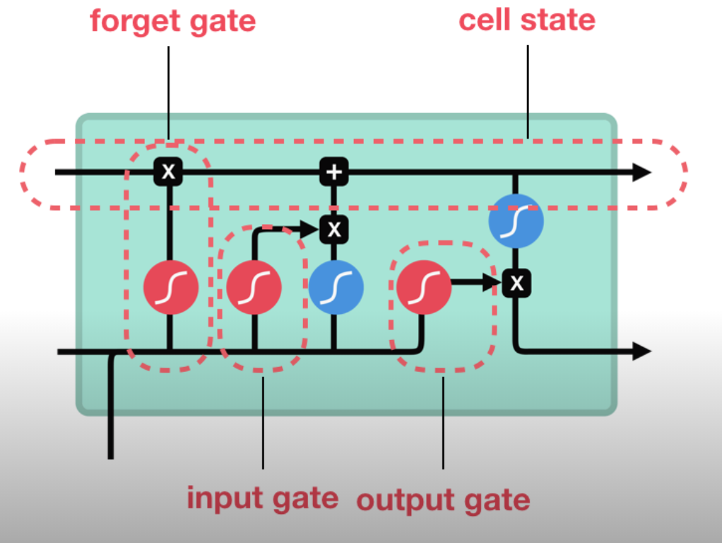
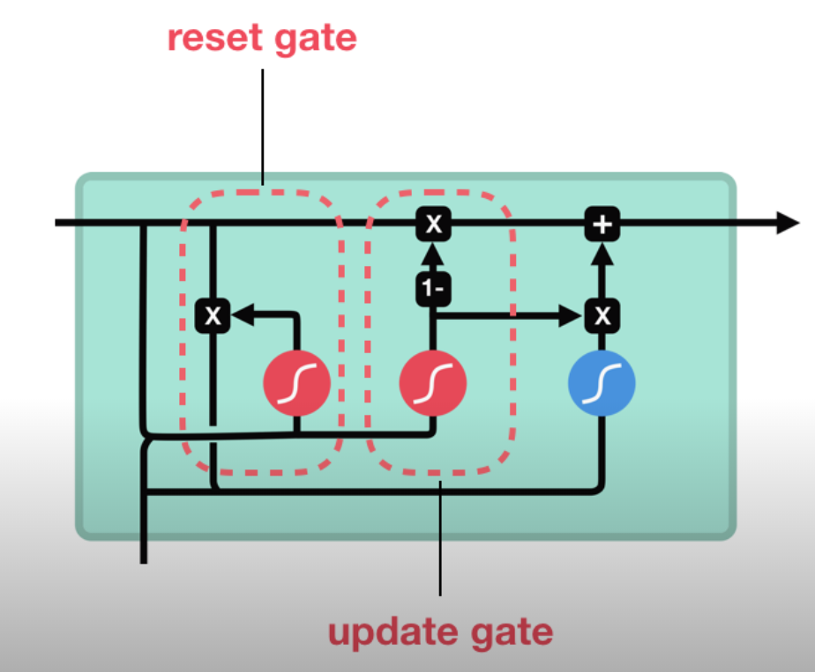
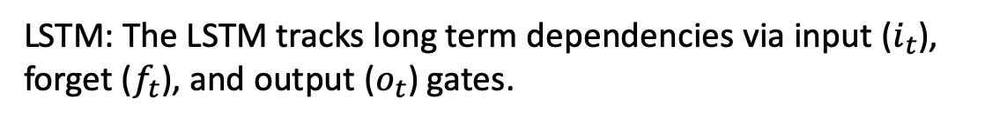
Semantic Embedding (RNN)
LSTM: The LSTM tracks long term dependencies via input ($i_{t}$), forget ($f_{t}$), and output ($o_{t}$) gates.
The input gate regulates how much of the new cell state to keep
The forget gate forgets a portion of existing memory
The output gate sends important information in the cell state to the next layers of the network
GRU: The GRU operates using a reset gate and an update gate.
The reset gate decides how much of the past information to forget
The update gate helps the model to determine how much of the past information needs to be passed to the future
Courtesy: http://penseeartificielle.fr/comprendre-lstm-gru-fonctionnement-schema/

Slide 14
Sentence Scoring
Processing flowchart of our approach
semantic
syntax
context
Extract Text
GROBID
Sentence Selection
ILP
Greedy
Phrase extraction
As bullet points
Slide generation
Title setting
Parse Text
StanfordCoreNLP
Sentence Labeling

Slide 15
Syntactic features
Some sentence features are extracted to improve the model performance:
Section: one-hot vector to represent the section of sentence.
We considered 6 sections for each paper:
Introduction, related work, model, result, conclusion, acknowledgement
Average of the label scores for each section shows the importance of that section for the summarization
section | Introduction | Related work | Model | Result | Conclusion | Acknowledgement
Average Score | 44.29 | 38.92 | 39.09 | 42.42 | 51.02 | 31.18
Number of sentences | 25494 | 18316 | 8924 | 6955 | 7036 | 722

Slide 16
Syntactic features
Relative position of the sentence in the section.
Parse Tree features:
#NP: number of noun phrases in the sentence
#VP: number of verb phrases
#S: number of sub-sentences
height: height of the parse-tree.
Stanford CoreNLP is used to generate tree structures of the sentences

Slide 17
Syntactic features
stop_word%: ratios of the stop words among tokens
#tokens: number of tokens
length: number of characters in the sentences
paper_title_similarity: Jaccard similarity of paper title and sentence.
section_title_similarity: Jaccard similarity of the section title and sentence.
average_IDF: Average of IDF scores of tokens of the sentence
average_TF: Average of the TF scores

Slide 18
Sentence Scoring
Processing flowchart of our approach
semantic
syntax
context
Extract Text
GROBID
Sentence Selection
ILP
Greedy
Phrase extraction
As bullet points
Slide generation
Title setting
Parse Text
StanfordCoreNLP
Sentence Labeling

Slide 19
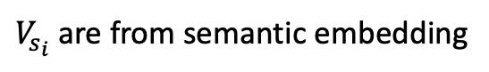
Context embedding
The context is defined as sentences before and after the current sentence.
Intuitively, the sentence that acts as a summary of its context is more important.
For instance, some paragraphs end with a sentence that summarizes the whole paragraph.
This sentence probably has a high word overlap with other sentences of the paragraph.
Contextual sentence relations are used as weights for sentence embedding
The context information is embedded as the following vectors.
$V_{s_{i}}$ are from semantic embedding

Slide 20
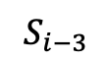
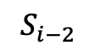
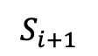
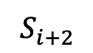

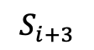
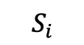

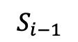
score
Context embedding
MLP
Syntactic embedding
$$Prev s_{i}$$
Next$s_{i}$
cos
cos
cos
cos
cos
cos
CNN
CNN
CNN
CNN
CNN
CNN
CNN
$$S_{i−3}$$
$$S_{i−2}$$
$$S_{i−1}$$
$$S_{i}$$
$$S_{i+1}$$
$$S_{i+2}$$
$$S_{i+3}$$
CNN
can be replaced by
LSTM
or
GRU
Notes:
Sentence summarization

Slide 21
Sentence Scoring
Processing flowchart of our approach
syntax
context
semantic
Extract Text
GROBID
Sentence Selection
ILP
Greedy
Phrase extraction
As bullet points
Slide generation
Title setting
Parse Text
StanfordCoreNLP
Sentence Labeling

Slide 22
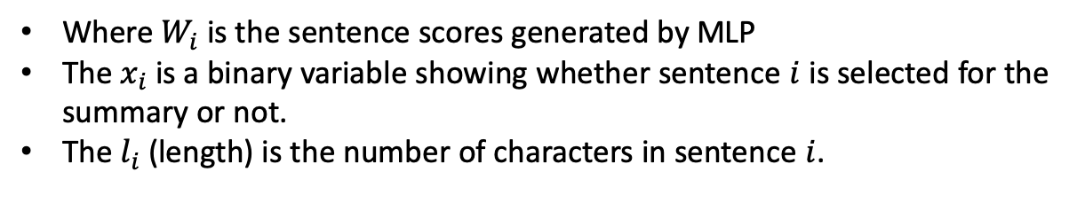
Sentence selection
Greedy:
Rank the sentences based on predicted score
Add sentences to the summary until length reaches the maximum allowed range
Sentences are added as long as their bi-gram overlap with existing summary is less than a threshold.
Integer Linear Programming (ILP):
Where $W_{i}$ is the sentence scores generated by MLP
The $x_{i}$ is a binary variable showing whether sentence $i$ is selected for the summary or not.
The $l_{i}$ (length) is the number of characters in sentence $i$.

Slide 23
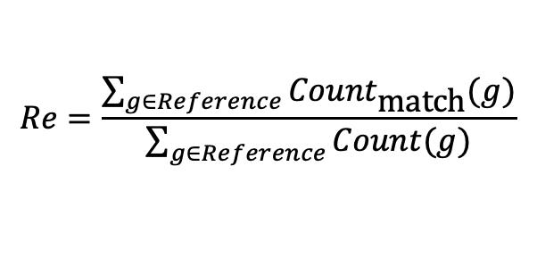
Evaluation
Evaluation metric:
Shared tokens between automatically generated slides and author made slides
ROUGE evaluation metric:
ROUGE-L is based on the Longest Common Sub-sequence (LCS).
ROUGE-W is Weighted LCS to differentiate LCSs of different spatial relations.
ROUGE-W gives more weight to the sequences that are spatially closer to each other.
$$Re=\frac{\sum_{g∈Reference}{{Count}_{\text{match}}(g)}}{\sum_{g∈Reference}{Count(g)}}$$

Slide 24
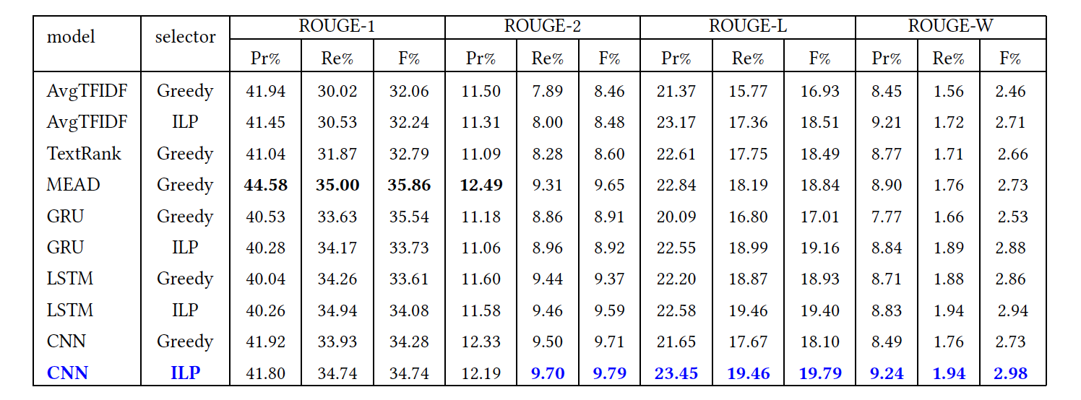
Result
MEAD is the publicly available platform for multilingual summarization and evaluation.

Slide 25
Bullets in Slides
Bullet points are noun phrases or shortened versions of sentences.
Some slides may contain second-level bullet points for further breakdowns.
Less than 8% of the content is covered in third-level bullets.
Each level-1 bullet includes 2 second-level bullets.
 | Average number of words
title | 4
Level 1 | 8
Level 2 | 8
One slide | 36

Slide 26
Noun Phrase Extraction and Slide Generation
Title setting:
Title of each slide is the section heading of the first sentence in the slides.
The content of the slides will be covered in first and second level bullet points
First level bullet points
Noun phrases are extracted from selected sentences and ranked based on the average frequency of their tokens
Some of the noun phrases are removed from the candidate set if:
They have more than 10 tokens
They have only 1 token
Their DF is higher than 10 ( such as ”the model”)
Second level bullet points
Selected sentences are second level bullet points
Verbose Slides:
If a slide is too verbose, it is split in to two distinct slides with same title and topic.
Maximum of 4 sentences are allowed per slide.

Slide 27

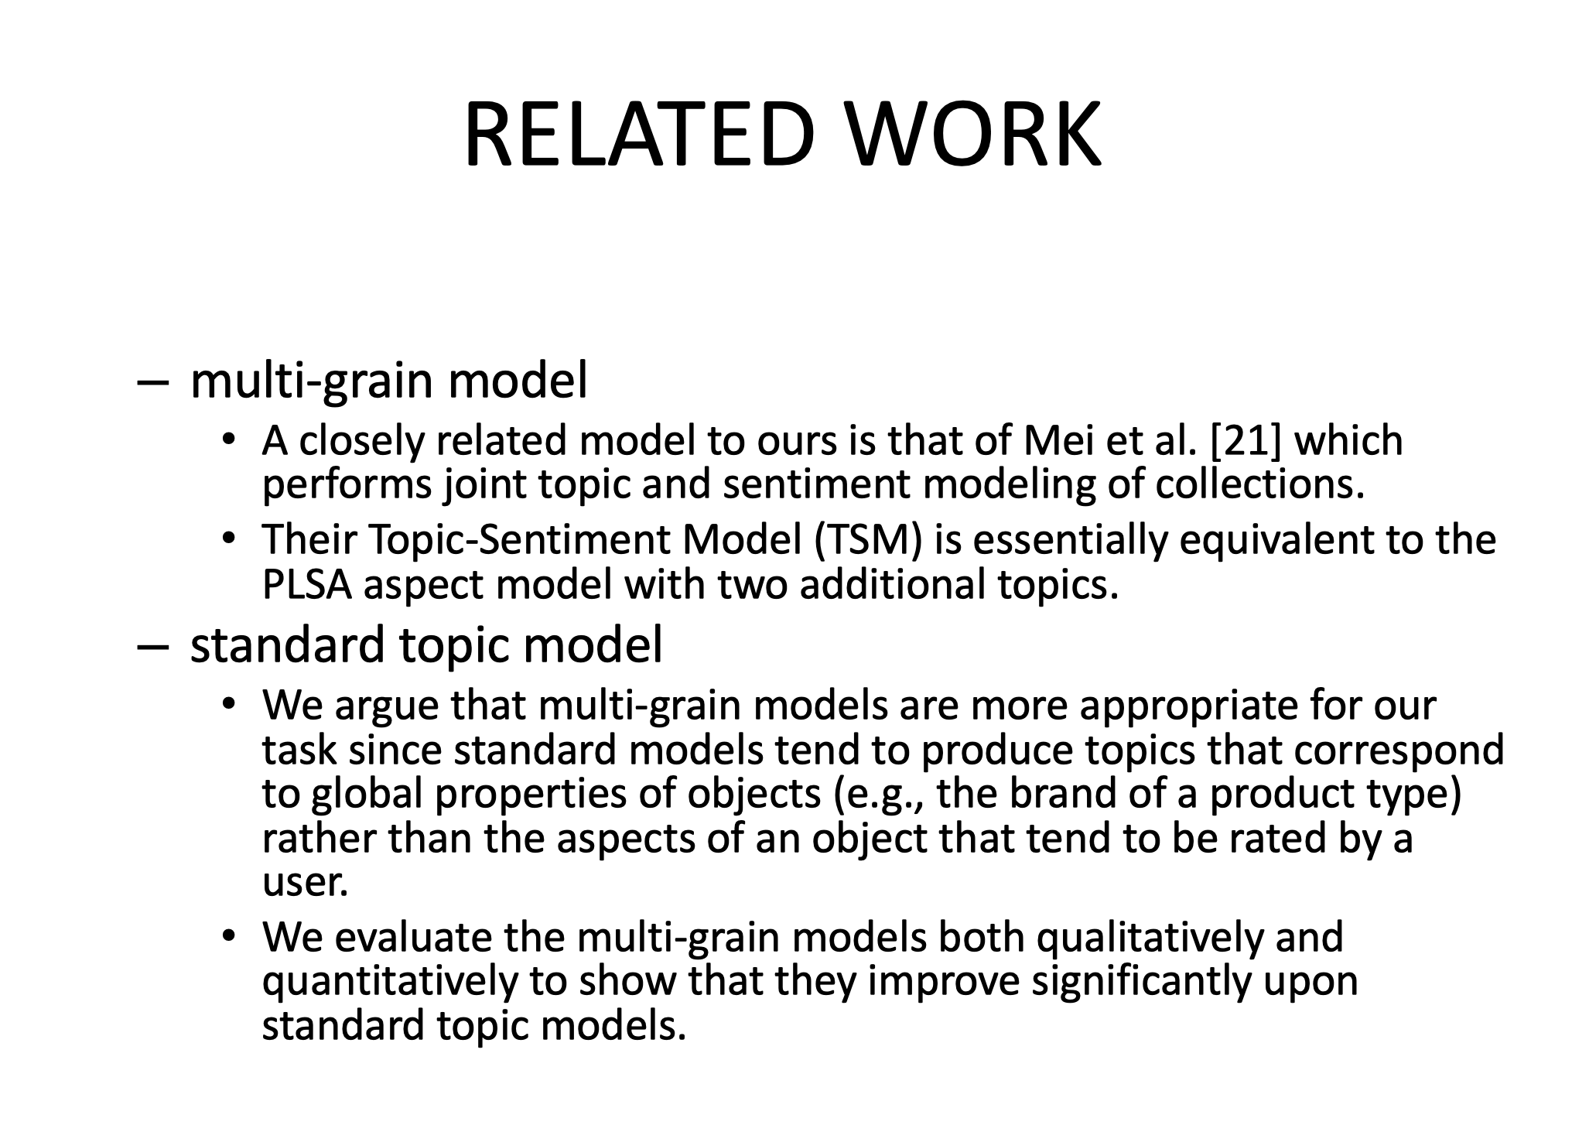
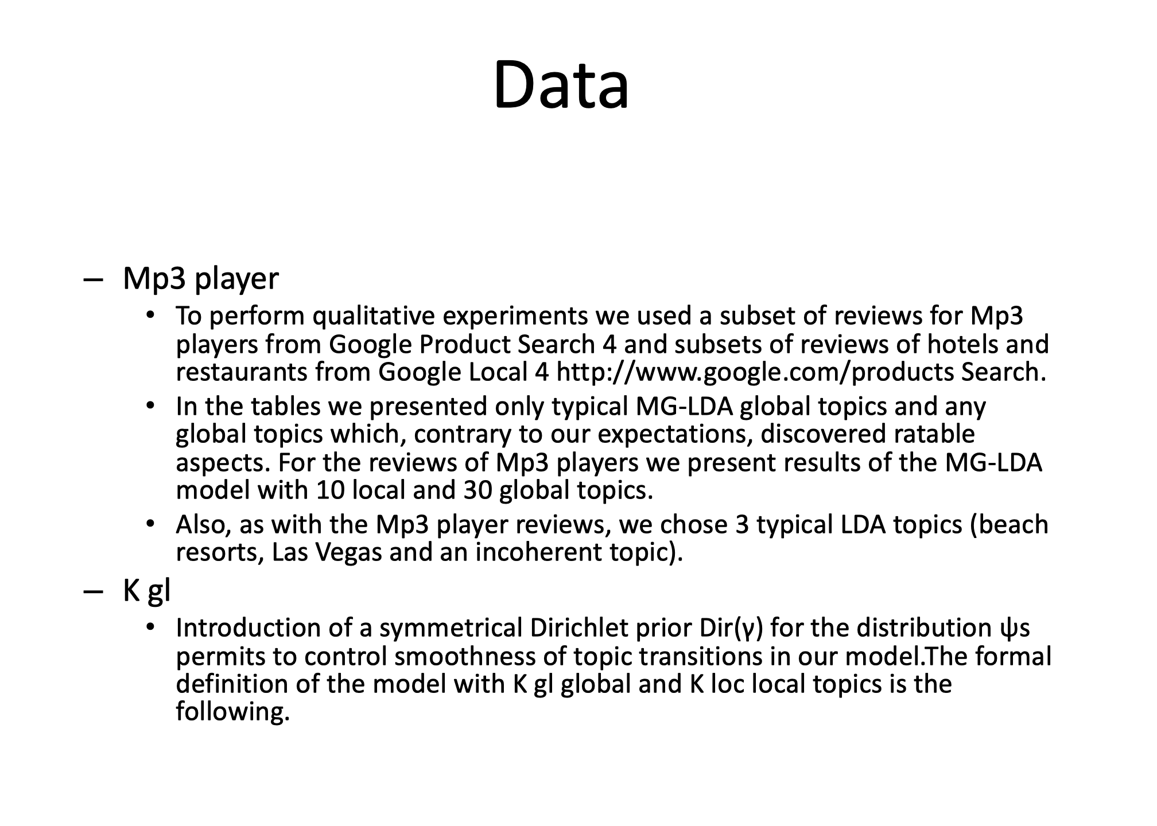
Example
1
3
2
4

Slide 28
Future work
Make sentences shorter for be suitable for slides
Add tables and figures
Extract images and charts
Add the appropriate context of the image to the slide
Try seq2seq models to avoid feature engineering in extraction process

